Slide 1
data centers’ architecture
Version | 3.1
Author(s) | L. Ariemma, G. Di Battista, M. Patrignani, M. Scazzariello, T. Caiazzi
E-mail | contact@kathara.org
Web | http://www.kathara.org/
Description | Data Centers’ Routing: Multipath, Fat-Trees

Slide 2
copyright notice
all the pages/slides in this presentation, including but not limited to, images, photos, animations, videos, sounds, music, and text (hereby referred to as “material”) are protected by copyright
this material, with the exception of some multimedia elements licensed by other organizations, is property of the authors and/or organizations appearing in the first slide
this material, or its parts, can be reproduced and used for didactical purposes within universities and schools, provided that this happens for non-profit purposes
any other use is prohibited, unless explicitly authorized by the authors on the basis of an explicit agreement
this copyright notice must always be redistributed together with the material, or its portions

Slide 3
Multi-Path
in a nutshell

Slide 4
Multi-Path
data center architectures allow to establish several paths between pairs of nodes
Multi-Path routing is used to
distribute and balance the traffic among different paths
increase the fault tolerance

Slide 5
Multi-Path
allows to have more than one next-hop for the same prefix in the FIB (Forwarding Information Base)
needs kernel support
the main OSes and routers support it
different usage policies can be applied
packets of the same flow should use the same path
reordering packets is computationally heavy

Slide 6
Equal-Cost Multi-Path (ECMP)
a specific approach to Multi-Path
exploits paths to the same destination that have the same “cost”
e.g., same IGP cost, same number of hops
allows to choose among the available paths in a uniform way
often used in Fat-Tree data centers
we’ll get there in a couple of slides

Slide 7
how packets are forwarded
for each packet, the kernel decides the FIB entry to be used
different policies are allowed
hash-based policy
Layer-3 hash (src IP, dst IP)
Layer-4 hash (src IP, dst IP, src port, dst port, protocol)
round-robin

Slide 8
Hyper-scale Data Centers
main concepts

Slide 9
a high-level architecture
Internet connections
multiple redundant high-speed fiber optic links
fabric
infrastructure designed to transport packets between servers and between servers and Internet
server farm
host applications and services

Slide 10
a high-level architecture
Internet
data center fabric
server farm

Slide 11
fabric architecture
why Fat-Trees?

Slide 12
overview – fabric architecture
real-life data centers
service model
data center network
traffic flow directions
requirements
components
topologies

Slide 13
real data center information – figures
links are fiber optic links
each link in the fabric is at least at 100Gb/s
each switch has at least 64 ports
about 5,000 switches/routers
about 60,000 servers

Slide 14
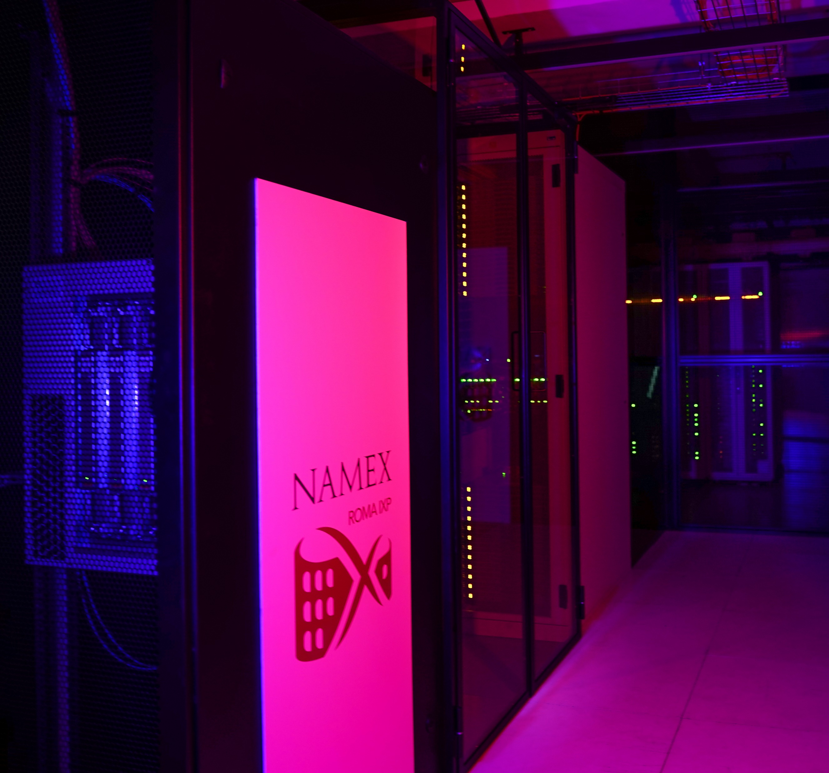
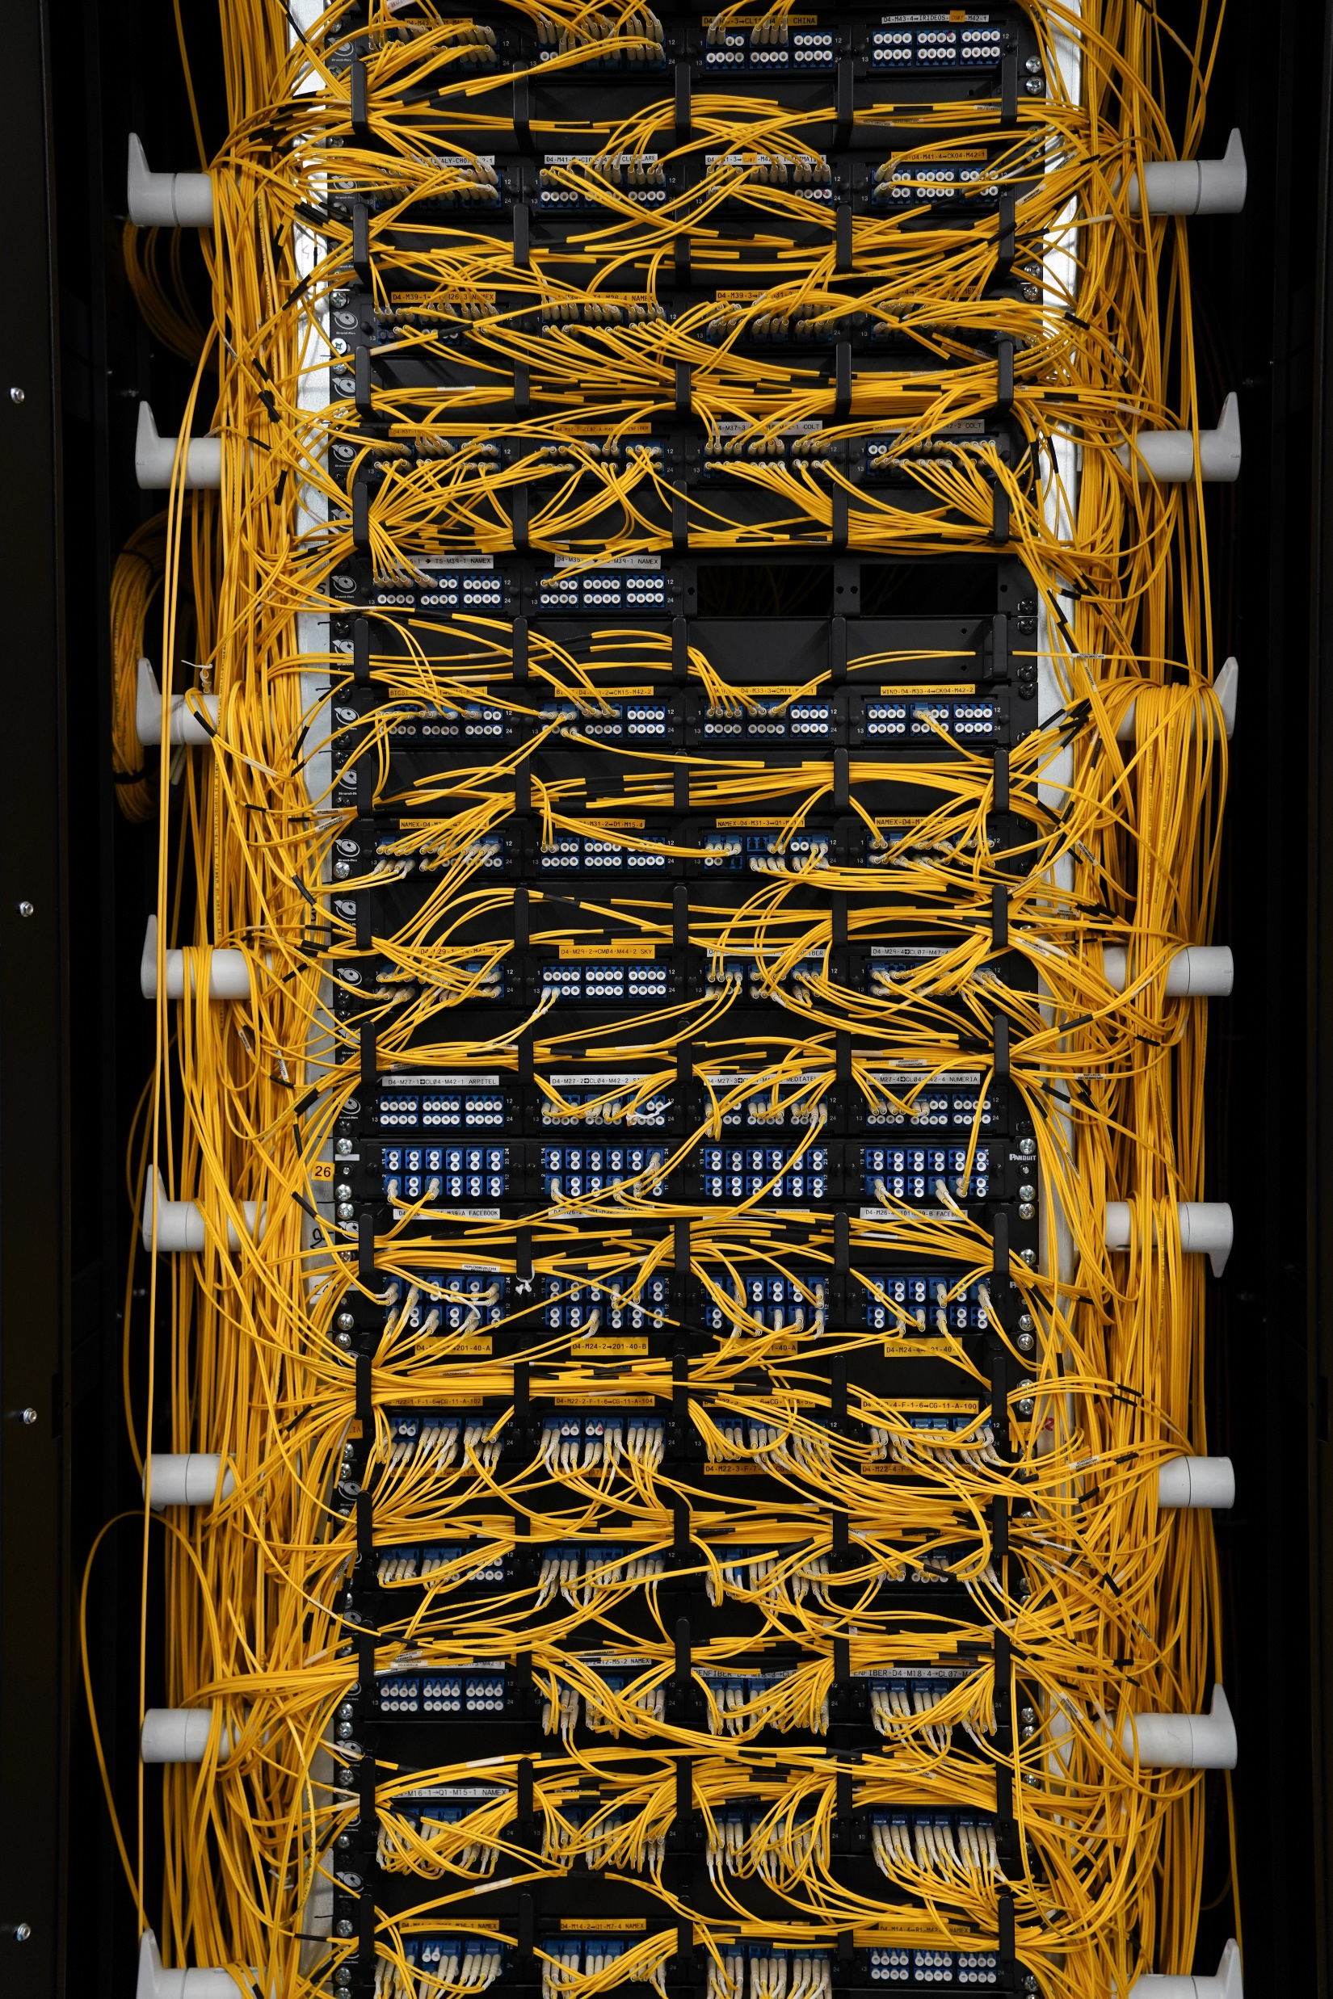

Slide 15
data center failures – yearly report
statistics by Google (2008) in a portion of data center composed of 1,800 servers:
1,000 individual machine (switch/router or server) failures
thousands of hard drive failure
1 power distribution unit failure
down for 500/1000 machines for 6 hours
1 cluster complete rewire (not simultaneously)

Slide 16
data center service models
three different service models
on-premise data centers
built, owned and operated by a company
often housed in a building of the organization
colocation data centers
built and owned by a company that rents space within the data center to other companies
the hosting company manages the infrastructure (building, cooling, bandwidth, security etc.)
the hosted companies provides the components, including servers, storage, and firewalls
cloud data centers
applications and data are hosted by a cloud service provider such as Amazon Web Services (AWS), Microsoft Azure, and Google Cloud Platform (GCP)

Slide 17
traffic flows inside a data center
two types of flows can be identified
traffic exiting or entering the data center
also called “north-south traffic”
data sent/received via Internet
server-to-server communications
also called “east-west traffic”: in data center schemata servers are typically drawn side-by-side
primarily, supports micro-services and distributed architectures

Slide 18
traffic flows inside a data center
north-south traffic
Internet
data center fabric
server farm
east-west traffic

Slide 19
data center network requirements
support high-bandwidth server-to-server communication
applications that rely on cluster computations, such as Hadoop or Spark, can involve hundreds or thousands of servers
customer’s containers/virtual machines (VMs) are distributed across multiple servers but need to communicate seamlessly
microservice architectures heavily rely on server-to-server communication
scale
data centers range from a few hundred to a hundred thousand servers in a single physical location
resilience
data center applications are designed to work in presence of failures

Slide 20
data center network components
data center nodes can be connected by using two network component types
specialized hardware
proprietary hardware that can scale to clusters of thousands of nodes with high bandwidth
e.g., Google Jupiter and InfiniBand switches
expensive option
commodity switches and routers
cheap option
widely adopted, this is the option we consider in the following

Slide 21
topology requirements
scalability
it should be possible to expand the data center
in other words, it must be possible to buy and deploy hardware similar to the one already deployed
bandwidth
hosts in the fabric should communicate with each other using the full bandwidth of their NICs

Slide 22
data center network topologies
several topologies have been proposed
Clos
Fat-Tree
VL2
Jellyfish
Xpander
DCell
...

Slide 23
Clos topology
invented by Edson Erwin in 1938 to address scalability issues in telephone networking
formalized by Charles Clos in 1953
the original problem was allowing N contemporary connections from N input lines to N output lines without using a single crossbar switch

Slide 24
Fat-Tree topology
Fat-Trees were originally introduced by Charles Leiserson in 1985
the Fat-Tree is a special case of a Clos
typical Fat-Tree architectures today consist of three level of nodes (switches/routers)
high redundancy
constant bisection of the available bandwidth
typically, nodes have the same characteristics
easier to stock spare equipments

Slide 25
Fat-Tree parameters
the Fat-Tree is a modular topology
two parameters define a Fat-Tree
radix of the nodes (even number, denoted by 2K)
number of available ports
redundancy factor (denoted by R)
usually, if the radix of a node is 2K it has K connections towards the north and K connections towards the south
different choices are possible, but not considered here

Slide 26
Fat-Tree nodes
Leaf
node connected to the server farm
Spine
node north of Leaves and south of ToF nodes
Point of Delivery (PoD)
set of fully interconnected Leaves and Spines
Top of Fabric (ToF)
set of top nodes that provide inter-PoD communication

Slide 27
an example of Fat-Tree: FT(K=2,R=2)
ToF (Top of Fabric)
aggregation layer
Spine
PoD (Point of Delivery)
Leaf
Server Farm

Slide 28
redundancy factor (R)
number of links between a ToF node and a PoD
max = K, min = 1
allow to connect more PoDs reducing the redundancy
R = 2
R = 1
Server Farm
Server Farm
FT(K=2,R=2)
FT(K=2,R=1)

Slide 29
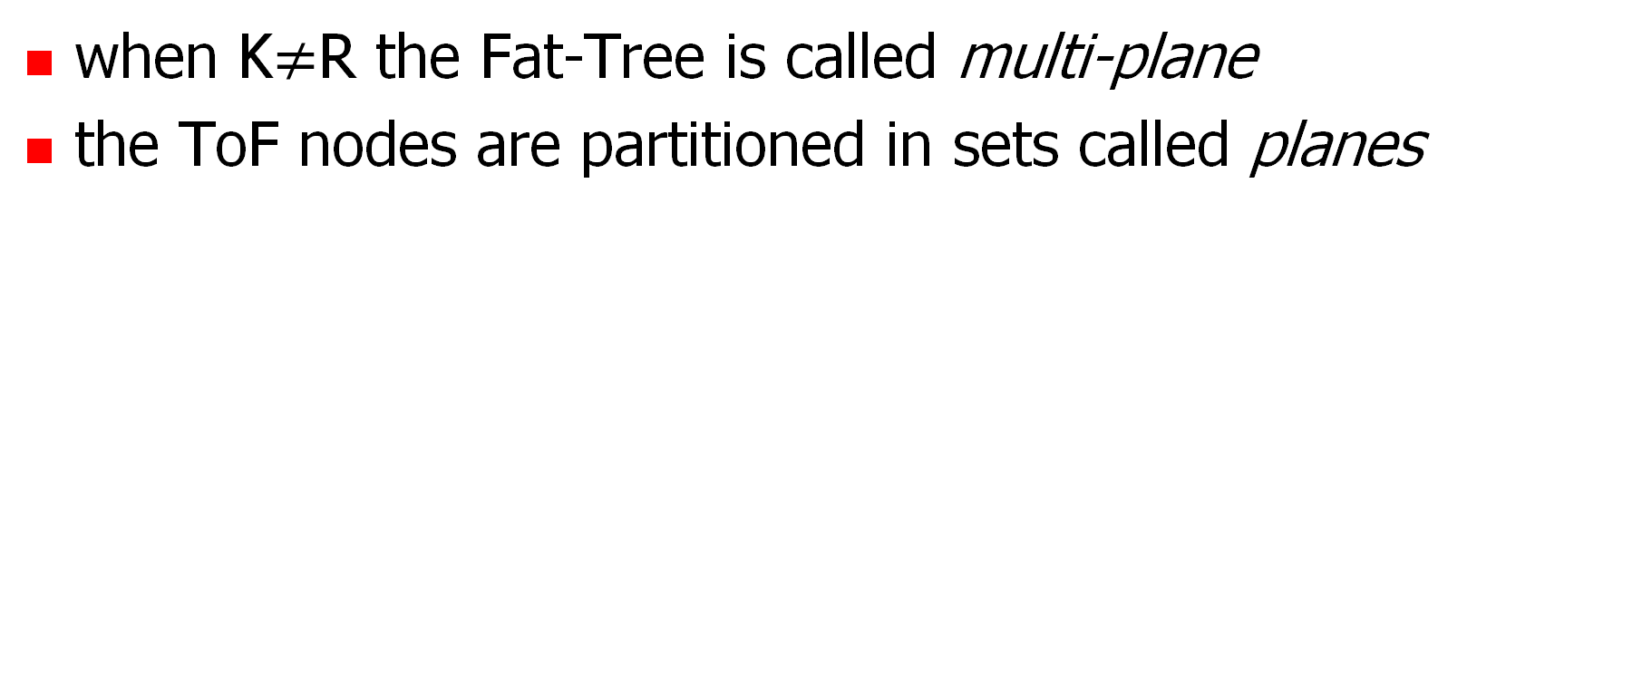
multi-plane Fat-Tree
when K$≠$R the Fat-Tree is called multi-plane
the ToF nodes are partitioned in sets called planes
Plane A
Plane B
Server Farm

Slide 30
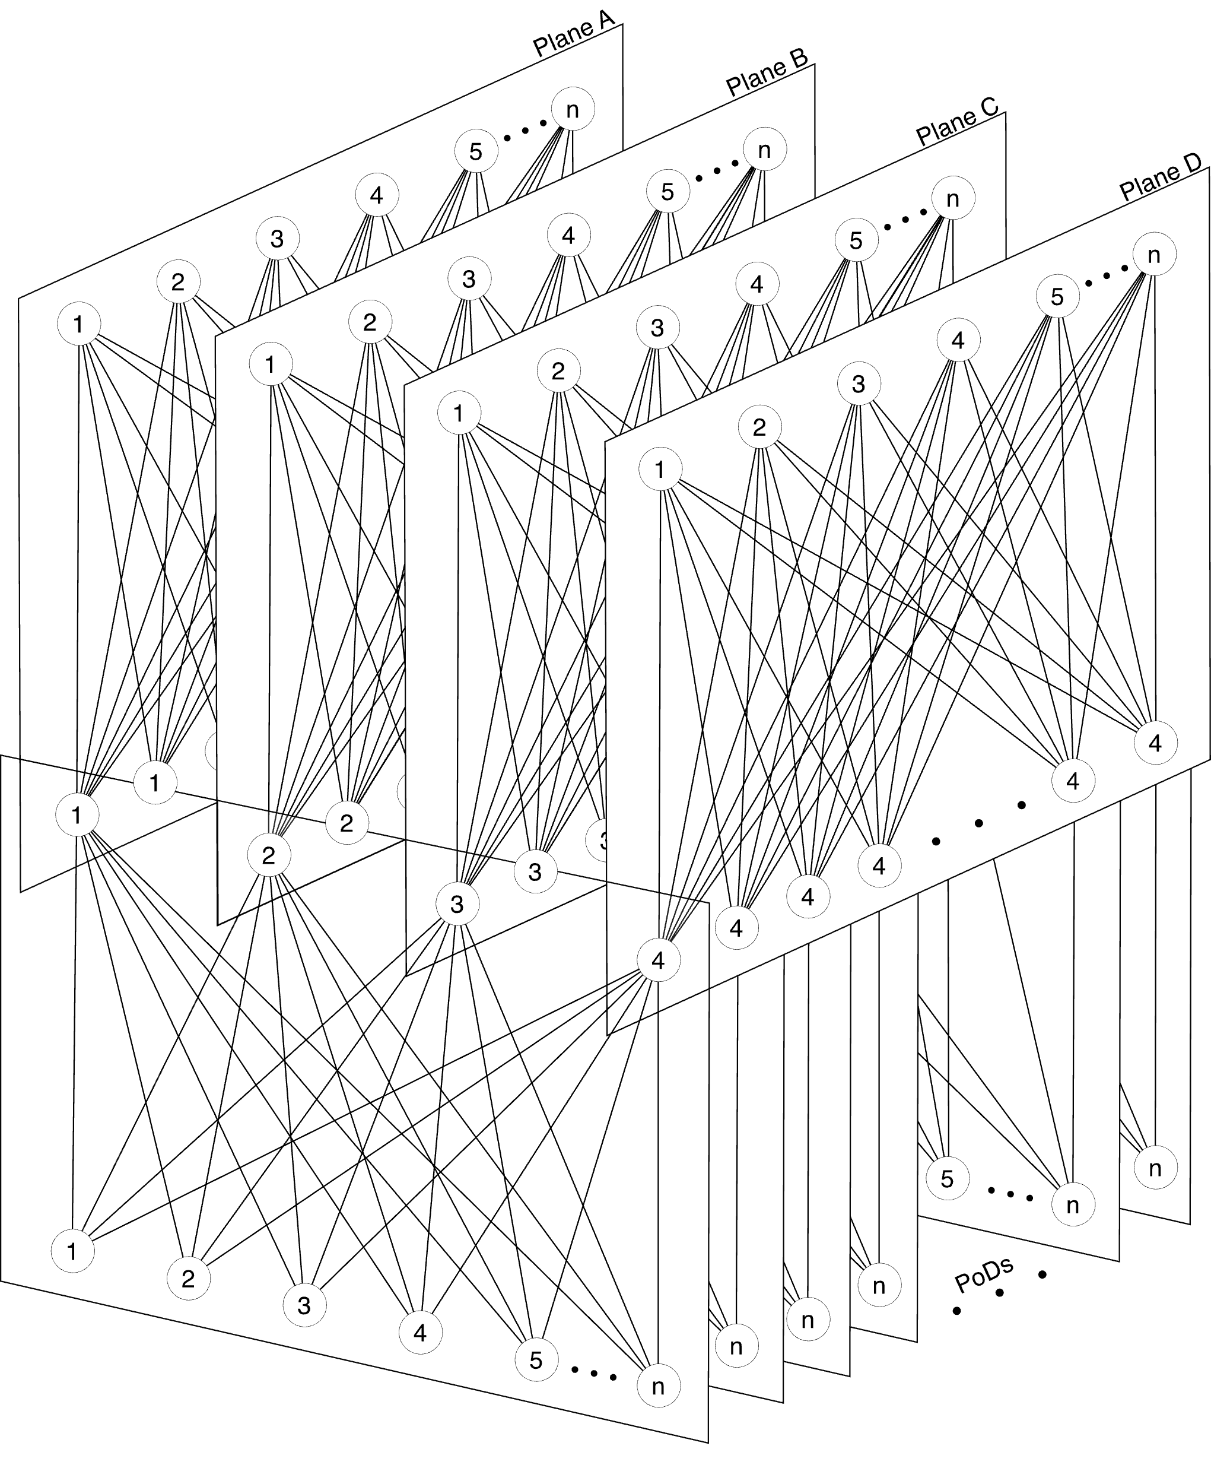
example of a multi-plane Fat-Tree
diagram from the IETF RIFT Draft

Slide 31
connecting a Fat-Tree to the Internet
two strategies
usage of a dedicated PoD
usage of ToFs
Internet
Internet

Slide 32
bibliography and further readings
[Caiazzi ‘22] Caiazzi, Scazzariello, Alberro, Ariemma, Castro, Grampin, Di Battista, “Sibyl: a Framework for Evaluating the Implementation of Routing Protocols in Fat-Trees“, NOMS 2022
[Caiazzi ‘21] Caiazzi, Scazzariello, Ariemma, “VFTGen: a Tool to Perform Experiments in Virtual Fat Tree Topologies“, IM 2021
[Caiazzi ‘19] Caiazzi, “Software Defined Data Centers: methods and tools for routing protocol verification and comparison”, Ms. Thesis, Roma Tre University, 2019
[Dutt ‘17] Dutt, “BGP in the Data Center”, O’Reilly, 2017
[RFC-7938] Lapukhov, Premji, “Use of BGP for Routing in Large-Scale Data Centers” Internet Engineering Task Force (IETF) Request for Comments: 7938

